Slide 1
House Price Prediction Using Linear Regression

Slide 2
Abstract:
The relationship between house prices and the economy is an important motivating factor for predicting house prices. Housing price trends are not only the concern of buyers and sellers, but it also indicates the current economic situation. Therefore, it is important to predict housing prices without bias to help both the buyers and sellers make their decisions. This project uses an open source dataset, which include 20 explanatory features and 21,613 entries of housing sales in King County, USA. With log transformation, feature reduction, and parameter tuning, the price prediction accuracy increased . Use of decision tree on same predictors also help us in determining which model fits the best .

Slide 3
Table of Contents :
Abstract
Introduction
Problem Statement
Research Objective and Hypotheses
Experimental Design
Data Analysis
Methods
Conclusion and Future Work

Slide 4
Introduction
Estimating the sale prices of houses is one of the basic projects to have on your Data Science CV. By finishing this article, you will be able to predict continuous variables using various types of linear regression algorithm.
Why linear regression? Linear regression is an algorithm used to predict values that are continuous in nature. It became more popular because it is the best algorithm to start with if you are a newbie to ML.
Using linear regression and decision tree can be feasibly implemented in python with the use of the scikit-learn package.
Finally, we conclude which model is best suitable for the given case by evaluating each of them using the evaluation metrics provided by the scikit-learn package.
Why Python?
Python is a general-purpose, and high-level programming language which is best known for its efficiency and powerful functions. Python is loved by data scientists because of its ease of use, which makes it more accessible. Python provides data scientists with an extensive amount of tools and packages to build machine learning models. One of its special features is that we can build various machine learning with less-code.

Slide 5
Problem Statement
1) Question the data - Understand the variables very carefully and formulate your questions/hypothesis. (Note that these are just your initial hypothesis which may or may not seem to be true after the EDA step) 2) EDA - explore the dataset very carefully. Do univariate analysis and bivariate analysis by choosing appropriate graphs, charts and descriptive measures. Report the surprising elements (i.e. the one which you believed would be true in step 1 did not turn out t be true, or a result that was beyond your expectation, etc.) 3) Initial model fitting step - FIt a couple of linear regression models by considering different sets of predictors on the training dataset. Argue the reasons for considering those predictor sets. Report 10-fold cross-validation RMSE and R-squared values. Discuss the results. 4) Feature engineering - (A) Suggest some possible feature transformations (like log(X), sqrt(X), X^2, X1*X2, etc.) with reasons, which you believe could have improved the performances of the previous models. Experiment to check if such transformations actually help to do so. (B) suggest some new feature generation techniques (e.g. creating dummy variables, or using one-hot encoding, or transforming an existing feature to a new feature as you may convert the variable 'year built' to the 'age of the house'. Check if such transformations help in improving the performances of the models. Report the RMSE and R-squared values in each case. 5) Model fitting step 2 - You may use model selection methods like (forward selection or backward elimination methods) to select an appropriate model. 6) Model fitting step 3 - Experiment and check if a decision tree model can be used to fit the data mode accurately. You are free to use any kind of hyperparameter tuning to fit the model. Experiment using all the feature sets you have created before (including all the transformed sets and new feature-generated sets). 7) Model testing - Consider the best competing models and test their performances on the test data. Report the results.

Slide 6
Steps Involved
Importing the required packages into our python environment
Importing the house price data and do some EDA on it
Data Visualization on the house price data
Feature Selection & Data Split
Modeling the data using the algorithms
Evaluating the built model using the evaluation metrics

Slide 7
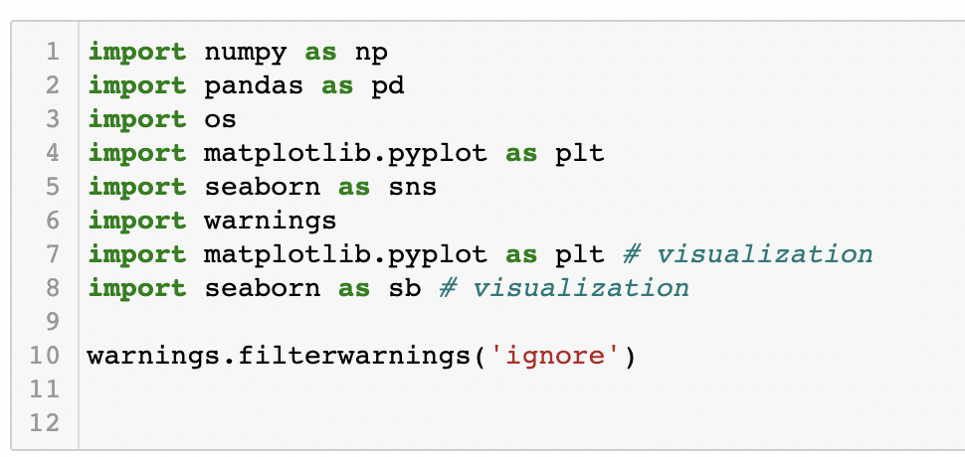
Importing required packages

Slide 8
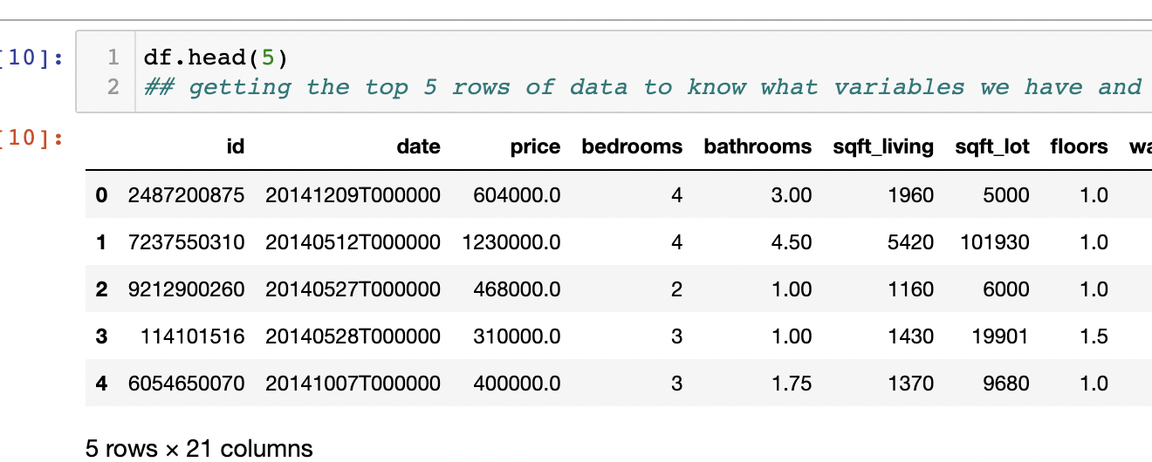
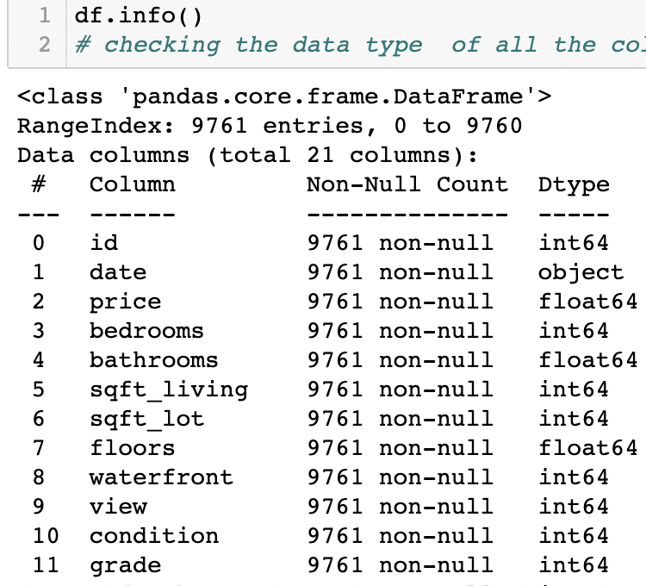
Importing Data & EDA
As I said before, we are going to work with the house price dataset that contains various features and information about the house and its sale price. Using the ‘read_csv’ function provided by the Pandas package, we can import the data into our python environment. After importing the data, we can use the ‘head’ function to get a glimpse of our datasetand ’info’ function to get glimpse of data type.

Slide 9
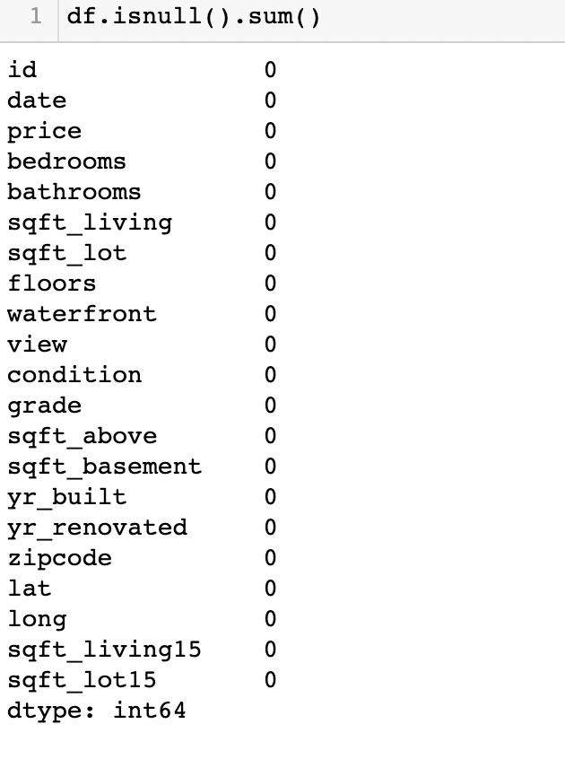
Missing Value Imputation
We will now check for missing values in our dataset. In case there are any missing entries, we will impute them with appropriate values (mode in case of categorical feature, and median or mean in case of numerical feature). We will use the isnull() function for this purpose.

Slide 10
Hypothesis :
looking at the data at first here are some questions and hypothesis comeup with which might not be true after EDA.
With first look at the data set variable like bedrooms seems to have correlation with price .In usual cases the more the number of bedrooms the higher the price of the property.
Variable like sqft _ liv(square foot living ) and comparing waterfront the more the sqft made for living the more spacious the house is and if waterfront is also available then they have some direct relationship with price of the property?
Age of the house/yr_build has been the deciding factor always while quoting or fixing the price of property?
Rating of Property being so modernized today with everything . Property do have ratings also which directly fluctuates the price.

Slide 11
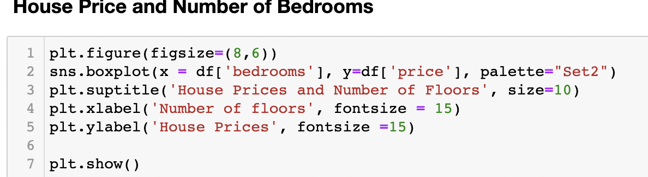
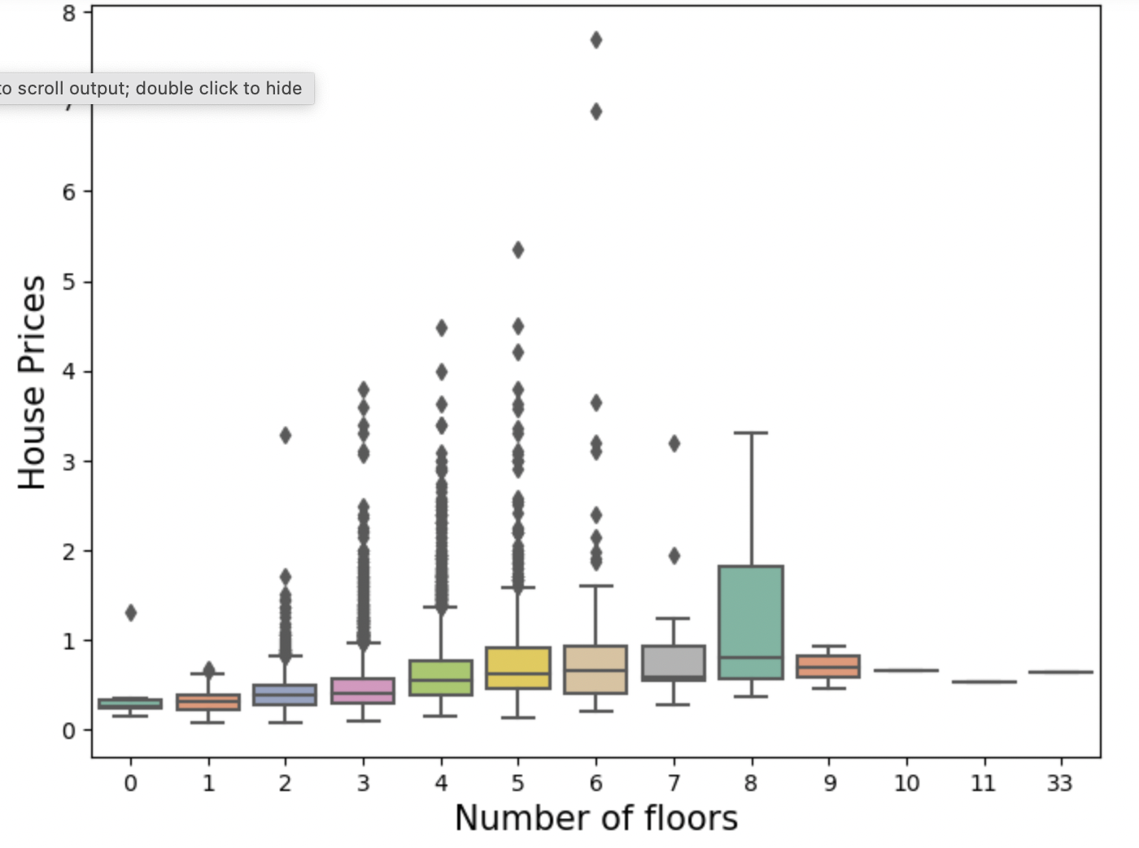
Data Visualization:
Observation about House and Bedrooms
There seems to be a general uptrend/linear relationship in price with the increase in the number of bedrooms
Lots of outliers exist in the data.
As the number approaches 8 bathrooms the price begins to fluctuate significantly.

Slide 12
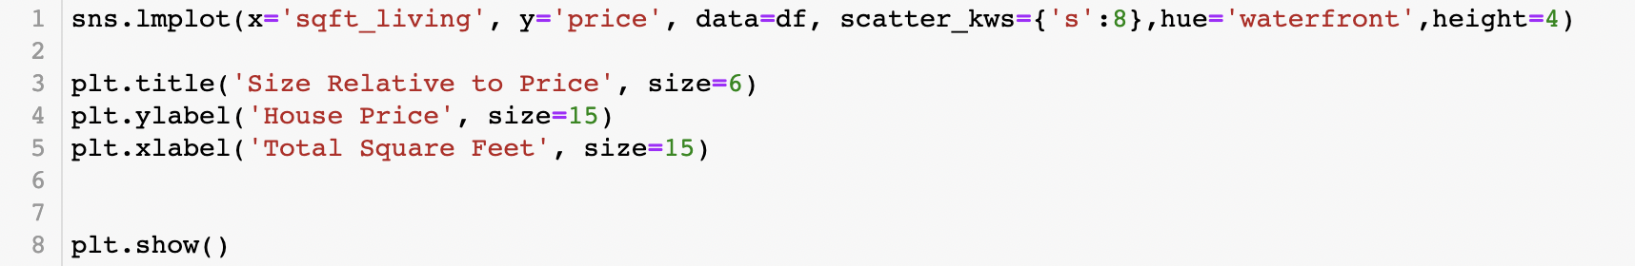
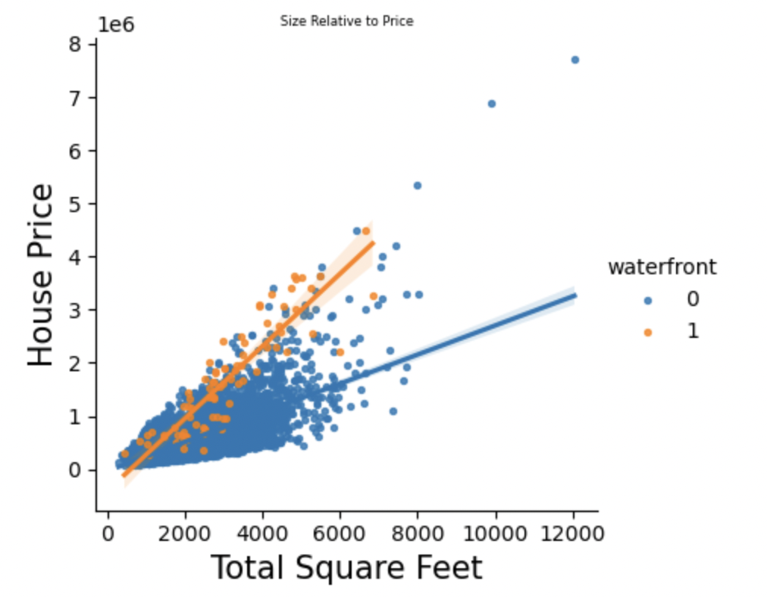
House Price and Water Front and Square foot Living
Observation¶
The baseline price for waterfront properties is higher on average than those without a waterfront.
As the house size increases, the price gap significantly widens between waterfront/non waterfront houses.

Slide 13
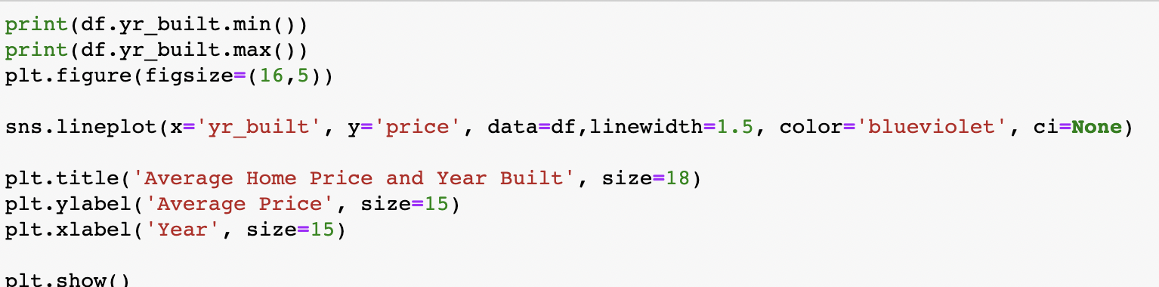
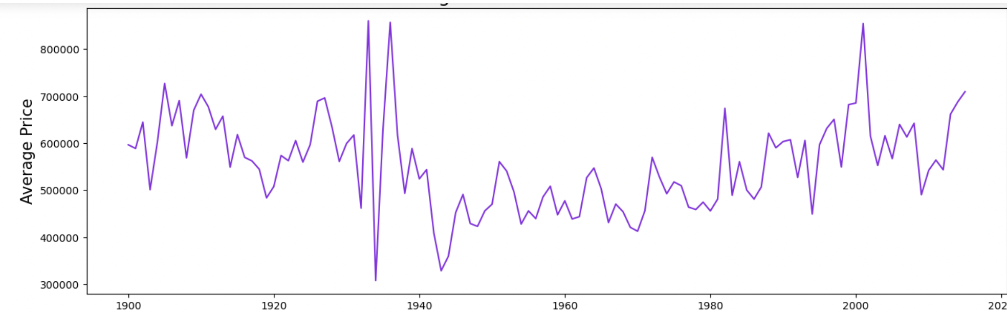
Year_Built and House Price
Observations
Houses built before 1940 and after 2000 have a higher average price.
Houses approximately between 1945 - 1980 cost less on average.
Is this possibly due to most very old houses (before 1940) having been renovated.

Slide 14
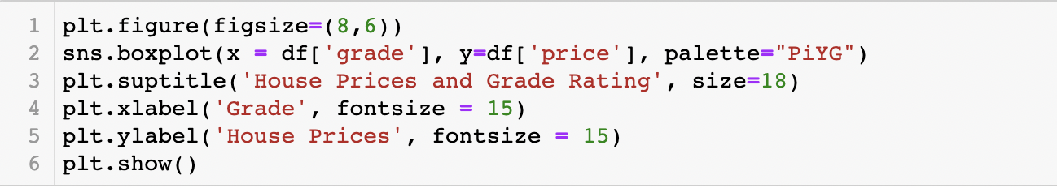
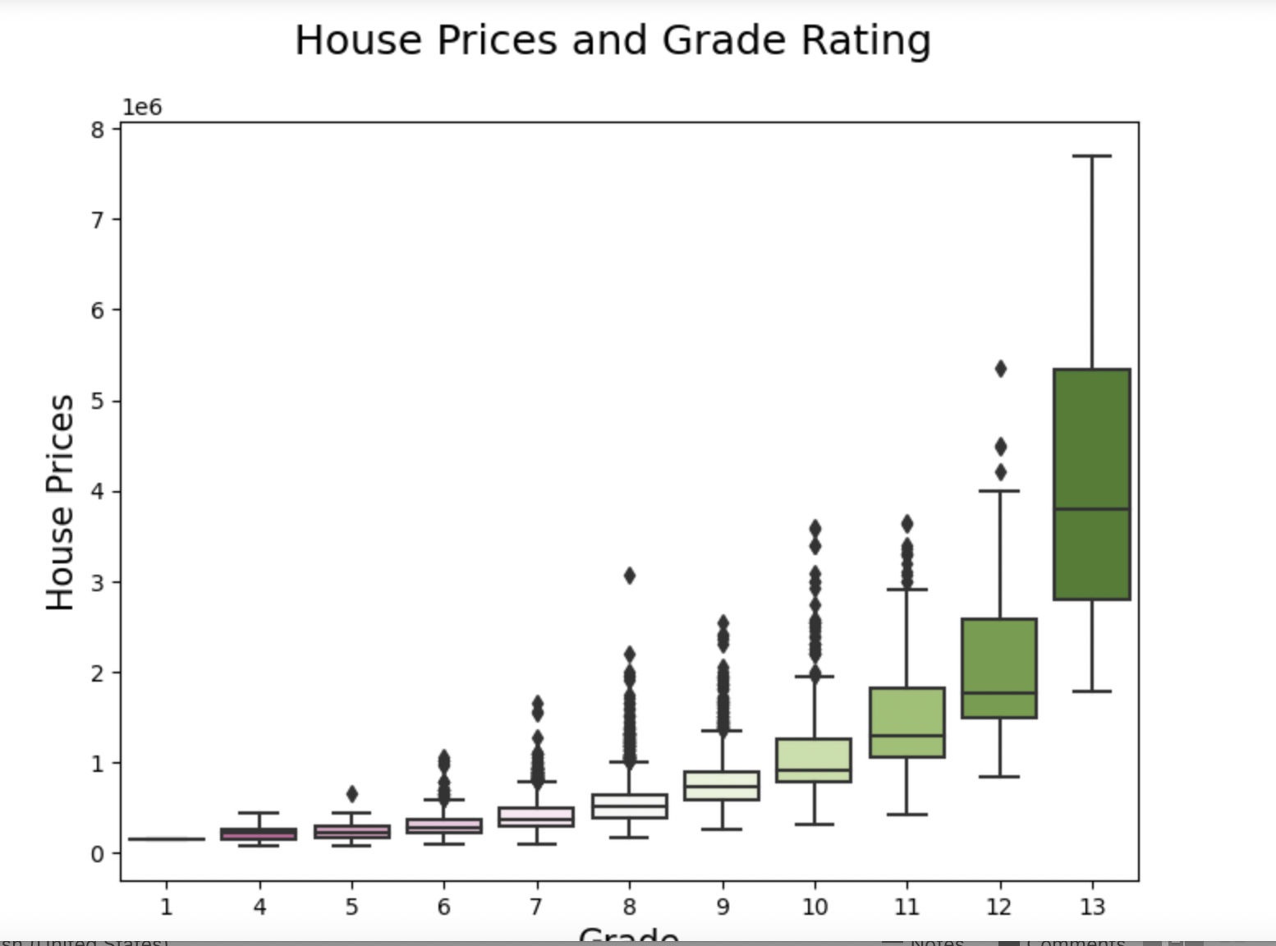
Rating of the Property and House Price
Observations
Description of Grade Rating:
"An index from 1 to 13, where 1-3 falls short of building construction and design, 7 has an average level of construction and design, and 11-13 have a high quality level of construction and design."
Many outliers in the data.
Significant increase in the price range as the grade increases.

Slide 15
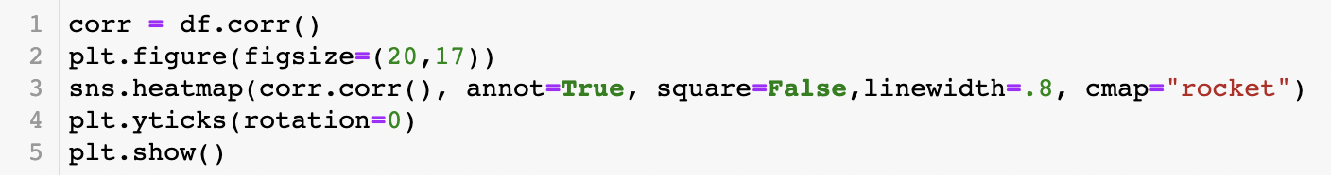
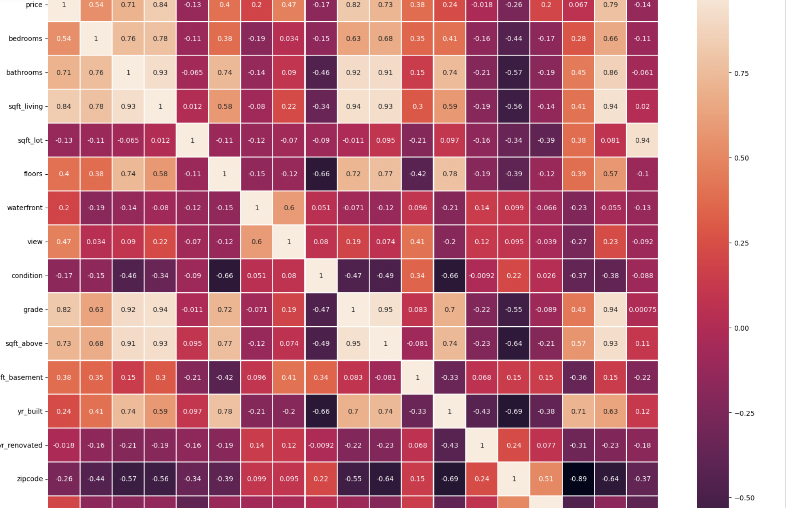
Heatmap of the Numerical Variables

Slide 16
Linear Regression
Linear Assumption. Linear regression assumes that the relationship between your input and output is linear. It does not support anything else. This may be obvious, but it is good to remember when you have a lot of attributes. You may need to transform data to make the relationship linear (e.g. log transform for an exponential relationship).
Remove Noise. Linear regression assumes that your input and output variables are not noisy. Consider using data cleaning operations that let you better expose and clarify the signal in your data. This is most important for the output variable and you want to remove outliers in the output variable (y) if possible.
Remove Collinearity. Linear regression will over-fit your data when you have highly correlated input variables. Consider calculating pairwise correlations for your input data and removing the most correlated.

Slide 17
Comparing the Metrics
MAE is the easiest to understand, because it's the average error.
MSE is more popular than MAE, because MSE "punishes" larger errors, which tends to be useful in the real world.
RMSE is even more popular than MSE, because RMSE is interpretable in the "y" units.
R2 R² tells us how well a model can predict the value of the response variable in percentage terms.

Slide 18
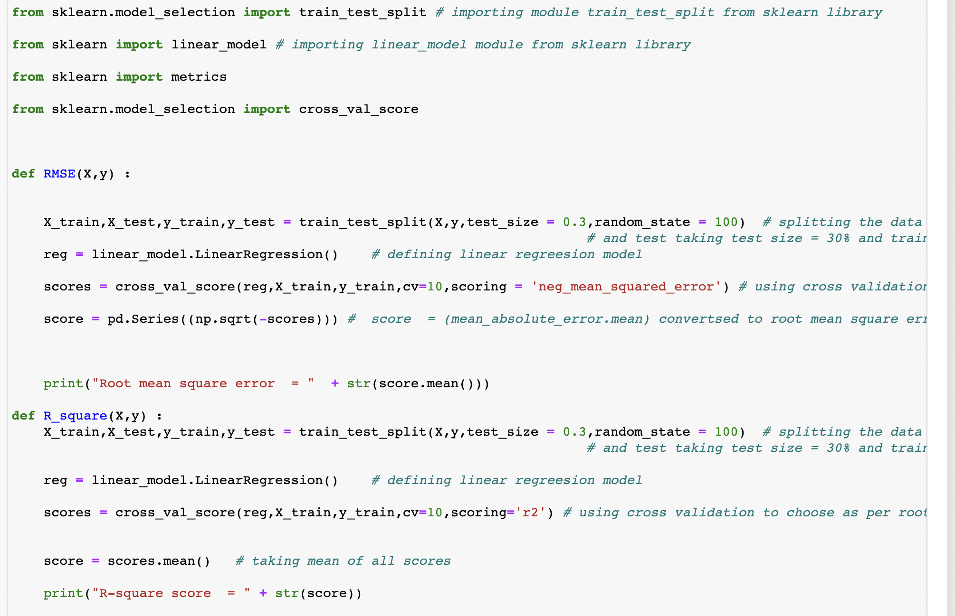
Fitting of linear regression model in Python

Slide 19
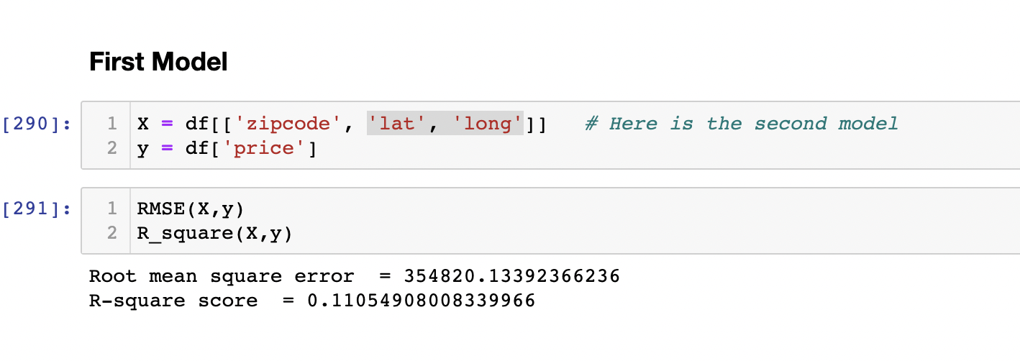
First model

Slide 20
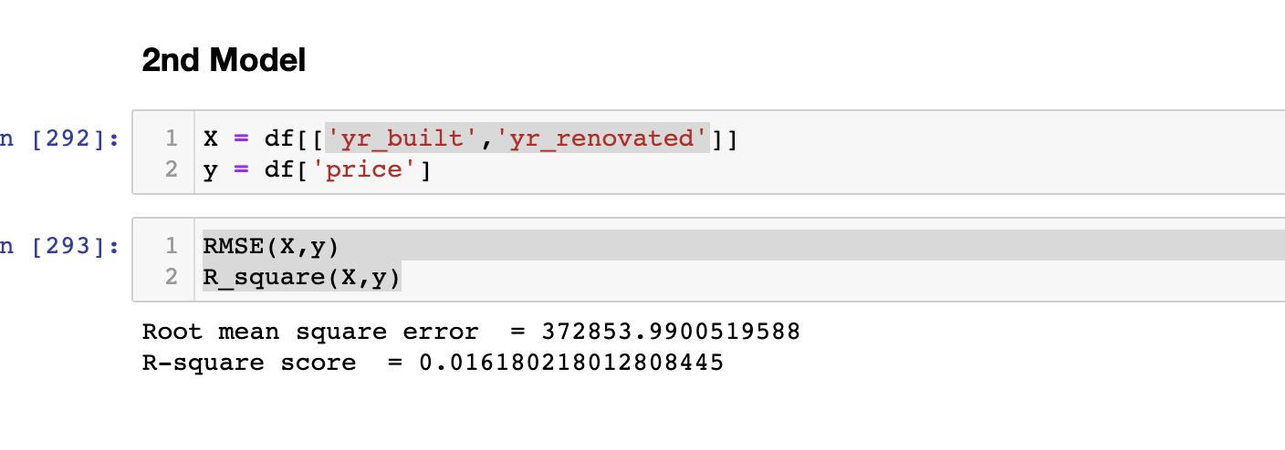
Second model:

Slide 21
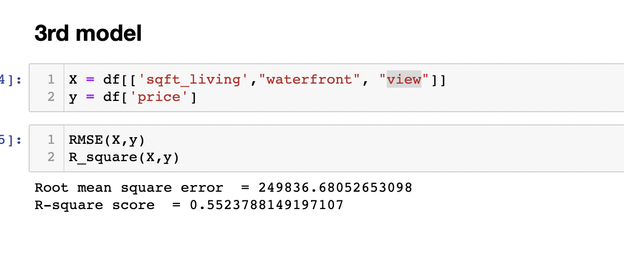
Third Model:

Slide 22
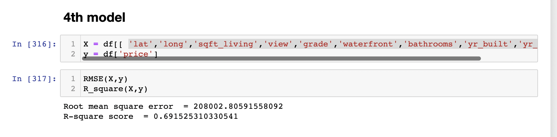
Forth Model
Observations From the Model Fitting
* Fitted a couple of linear regression model.
* Observed that in the first model zip code ,latitude ,longitude has less R2.
* Observed alone year built and year renovated does not contribute much to the price.
* New set of predictors taken sqft _ living , waterfront shows significant increase in R2.
* Then 4rth model taken ‘ latitude ', 'long', ‘sqft _ living', 'view’ , 'grade', 'waterfront', 'bathrooms', ‘year _ built’, year _ renovated'** shows the increased .

Slide 23
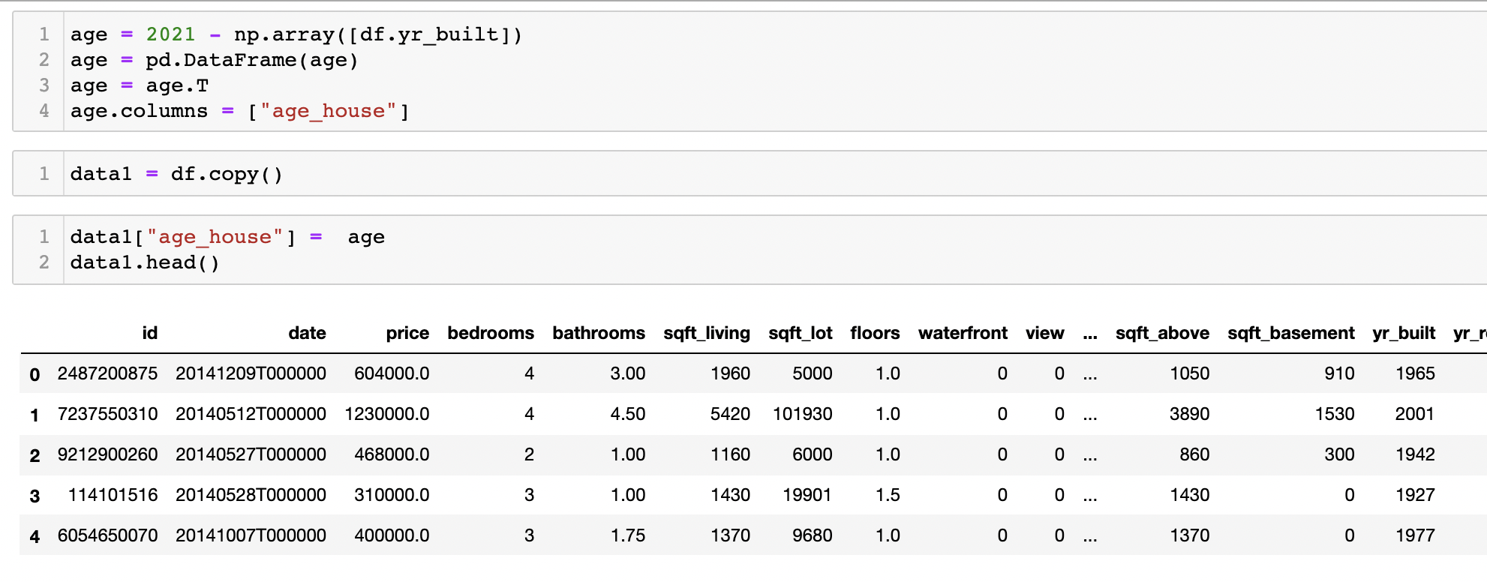
Feature Engineering
Linear regression assumes that the relationship between predictor and target linear.
Therefore may need to transform data to make the relationship linear, therefore log transform for an exponential relationship]
Using log transformation , to solve the skewness and bring together the spreader data

Slide 24
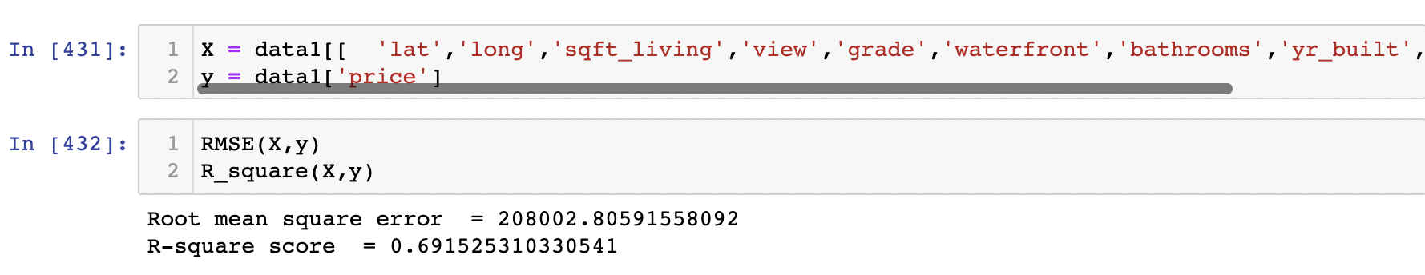
Scores of the model after Feature Engineerings
There is no difference for us after using feature selection. Where we did feature engineering on age of the house.

Slide 25
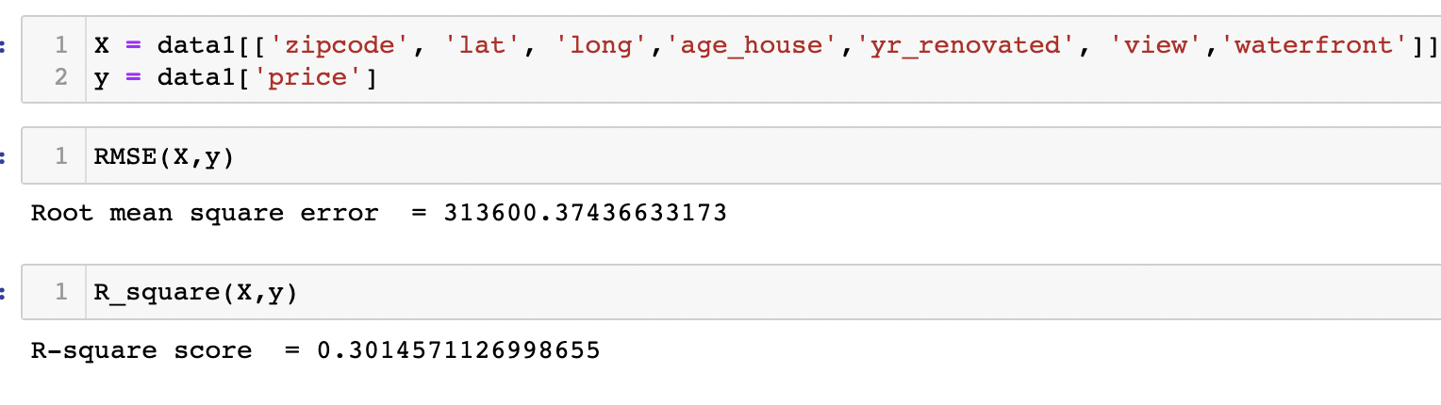
In feature Engineering
We actually altered the year built column by subtracting the same with current year 2021 and the result was the age of the house .
For Square foot living in two dimensions we changed into one dimension but this change does give any different output.
Square root of the property column variable

Slide 26
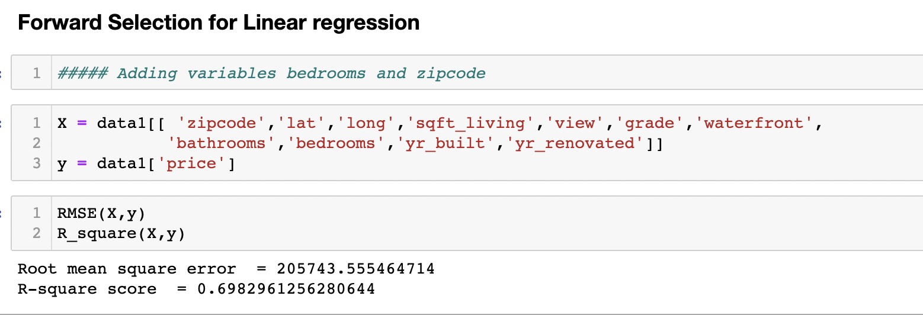
Forward and Backward Selection
In forward selection we actually added two more variables as predictors .
Bedrooms
zipcode
Findings are Our RMSE fall to a great extent .

Slide 27
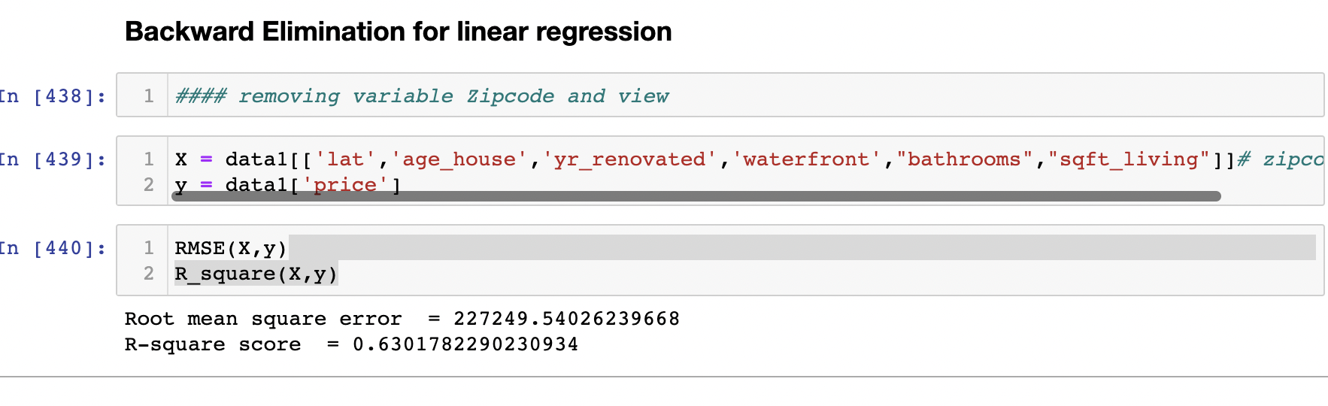
In backward selection we removed Zip code and view. RMSE is less as compared to initial model but little on higher node as compare to forward selection model.

Slide 28
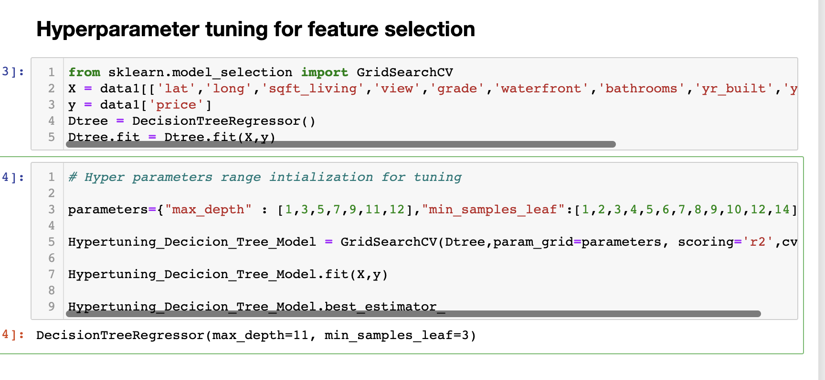
Hyper parameter turning feature Selection.

Slide 29
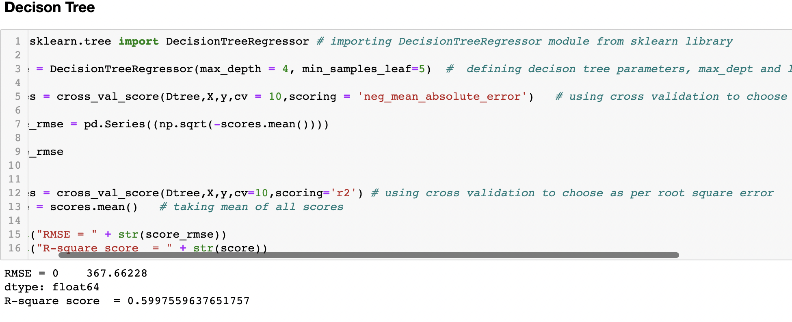
Decision Tree

Slide 30
Why on Test Data separately:
A model is set to be performing if it performs well on unseen data. So let it consider population of size n and let us suppose we have the liberty to extract two random samples S1 and S2 of size n1 and n2 respectively drawn from the same population.
We use the models to make the predictions on the test data. Performance like RMSE,R2 are used to guage the performance of the model on the test data .Lower the model value of these Error Matrix.
The better the model is.

Slide 31
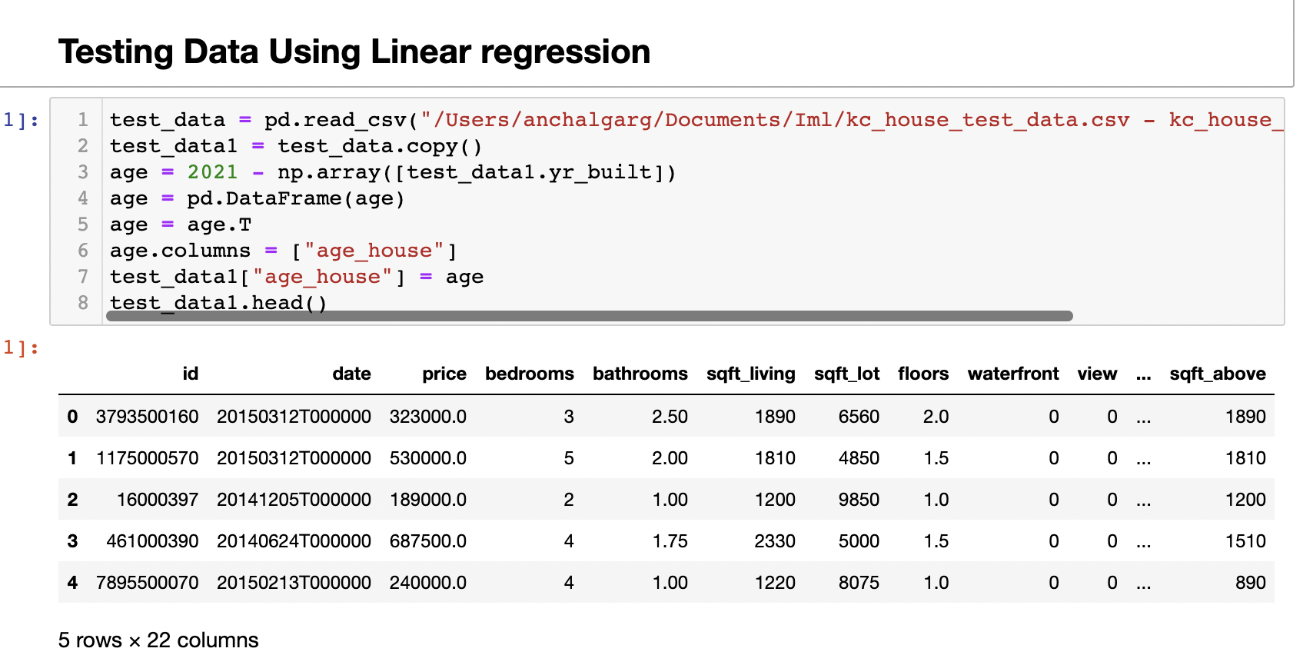
Linear Regression On Test Data

Slide 32
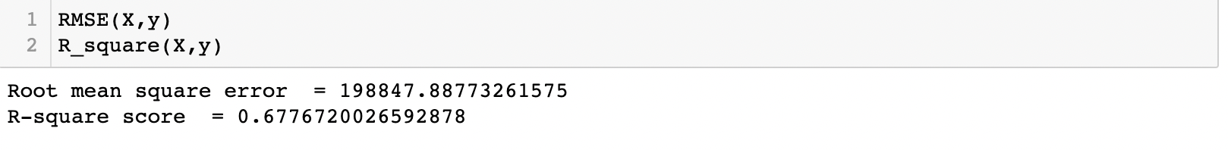
Result of Testing data on linear Regression:

Slide 33
Conclusion and Future Work
This project conducts several experiments on applying Linear regression and showing correlation between various features . For Linear Regression Experiment, we used seventeen variables into different combinations to find out which combination of model fits best and plays an important role in price determination. The experimental results show that there is difference between the performance of the models . 4 th model achieved highest 0.69 R-square. Scores after feature engineering have significant effect. Applied the same set of variable on decision tree model as well. The best combination of parameter that achieves the highest R-square score is . This project only uses King County City Data. Used Various forward and backward selection to improve the RMSE score. After learning the model on train data . Applied the model on test data. And found the result significant as 0.67 is R-square on test data.

Slide 34

This Photo by Unknown Author is licensed under CC BY

